Slide 1
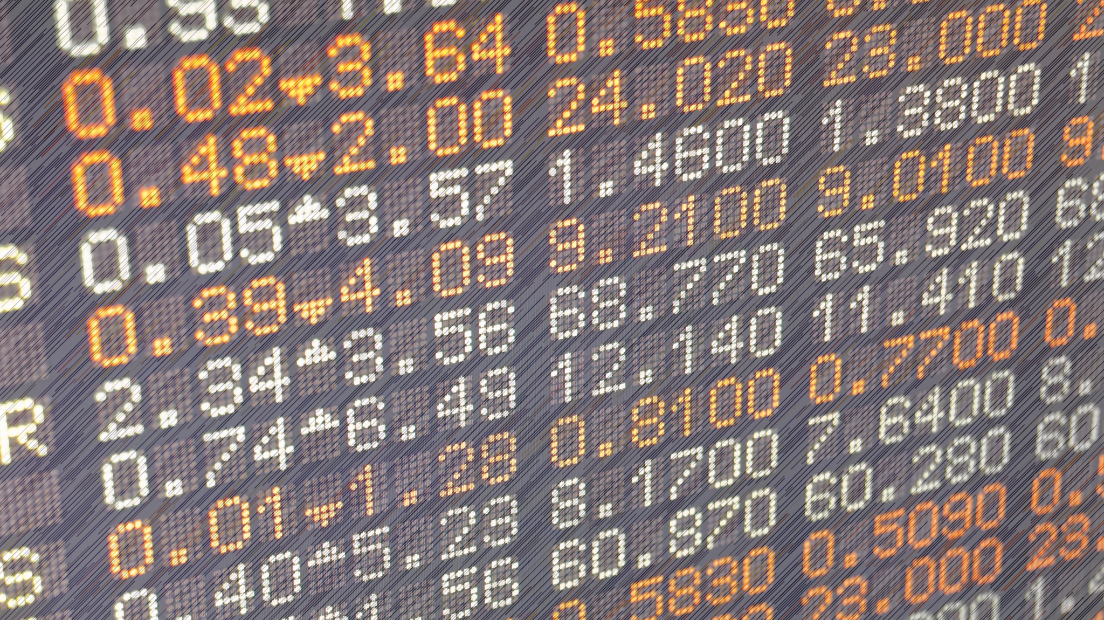
OTC Market
OTC Engineers
Sanjit Guliani, Pujan Patel, Samantha Soto

Slide 2

Business Problem
OTC markets are decentralized markets where trading of financial instruments, such as stocks, commodities, and derivatives, occurs directly between two parties without a centralized exchange or broker.
Problem:
No broker, who’s knows what type of trading is happening and between who?
Lack transparency & regulations - contribute to higher potential returns but also comes with increased risks for buyers.

Slide 3
Business Impact
Benefit:
Improved decision making processes and strategy developments for investors.
Risks and Costs:
Handling financial data is particularly tricky because we need to ensure strict security measures to protect against data breaches and maintain privacy.
OTC market data constantly updates. To handle constant updates, a robust IT infrastructure is needed, which can handle high volumes of data transactions in real-time. Significant amounts of storage is needed & it needs to be protected.
Processing this data & storing it in a Datawarehouse can act as a centralized repository for market data.
Historical data to discover patterns, improve their investment strategies and risk management.

Slide 4


Business Persona
Users: Financial analysts, traders, risk managers, decision-makers.
Actors in the system: Those involved in OTC market analysis and decision-making.

Slide 5

Data
OTC Market Transactions, type csv
Source: Stakeholder Bien-Aime!

Slide 6
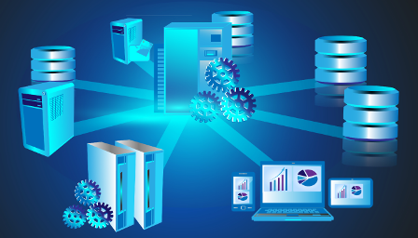
Process
Source
Download to local computer
ETL:
Extract
Transform
Load
Datawarehouse
Visualization

Slide 7
Method
Dimensional Modeling
Extracting and storing to S3
Retrieve data from S3 and transformed
Stored it back to S3
Created AWS Redshift serverless
Created tables
Loaded data in AWS redshift
Visualize using Tableau

Slide 8
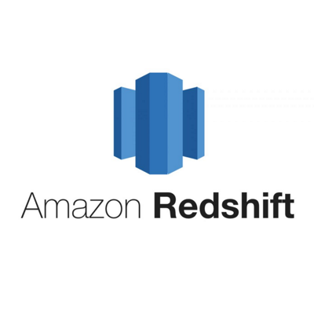



Tools Utilized
ETL - Python
Pandas
AWS
S3 bucket
Redshift
Tableau

Slide 9
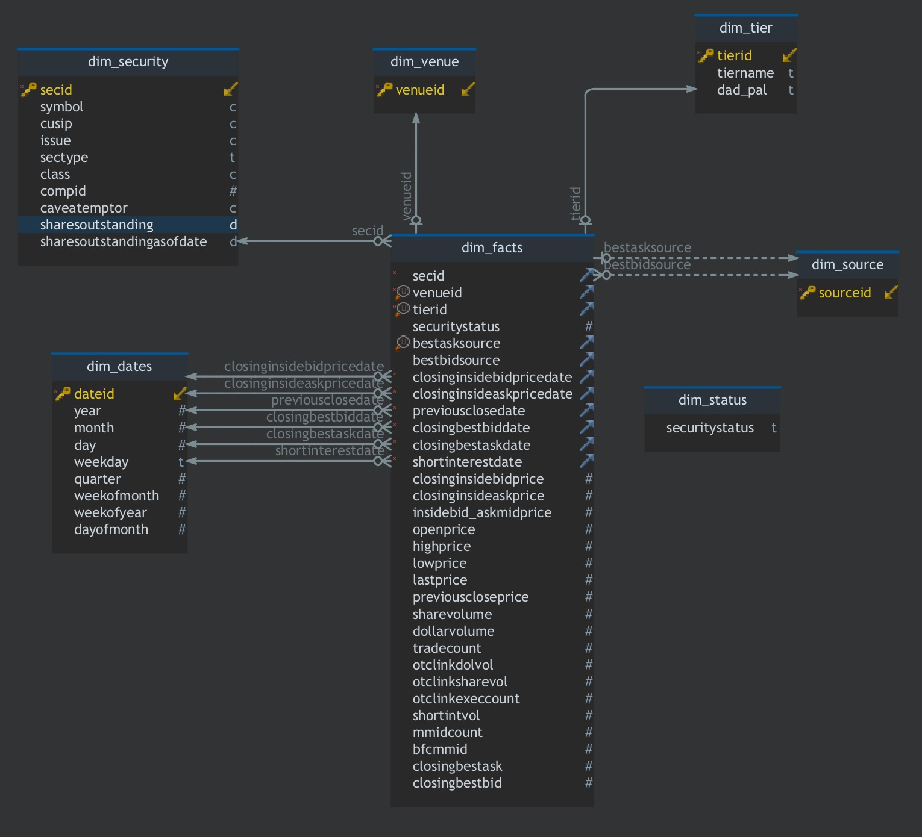
Dimensional Modeling

Slide 10
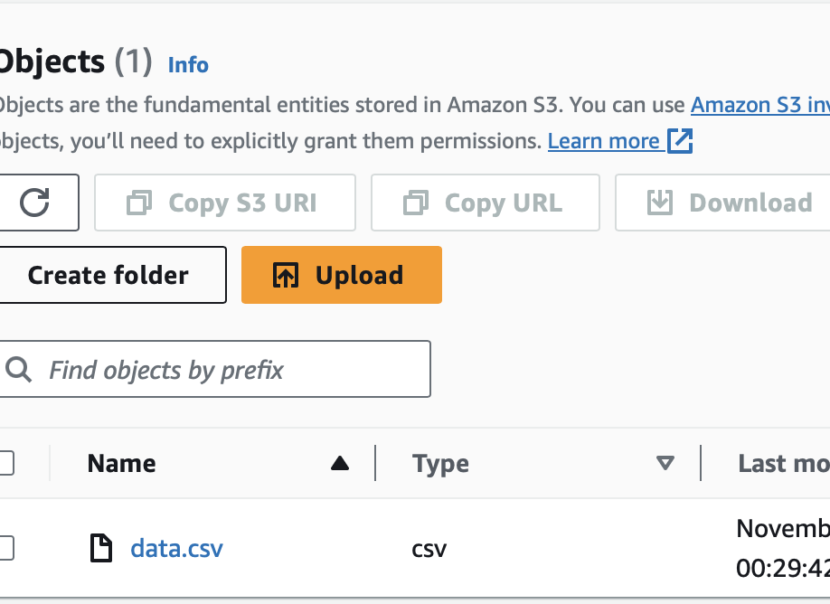
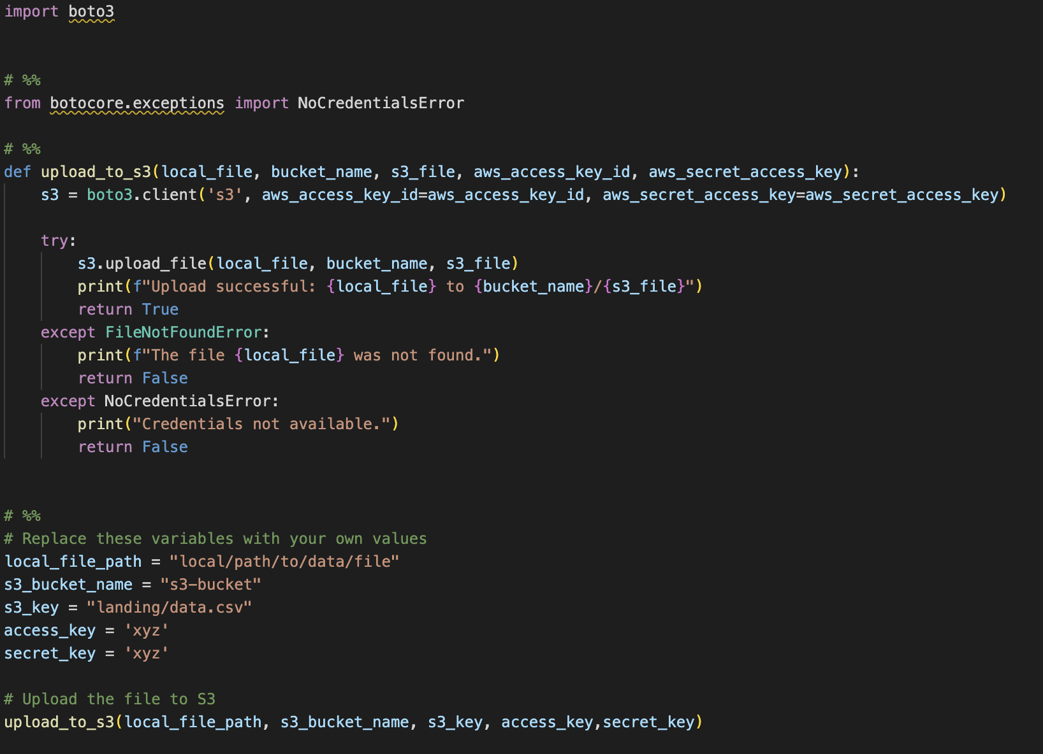
Extract

Slide 11
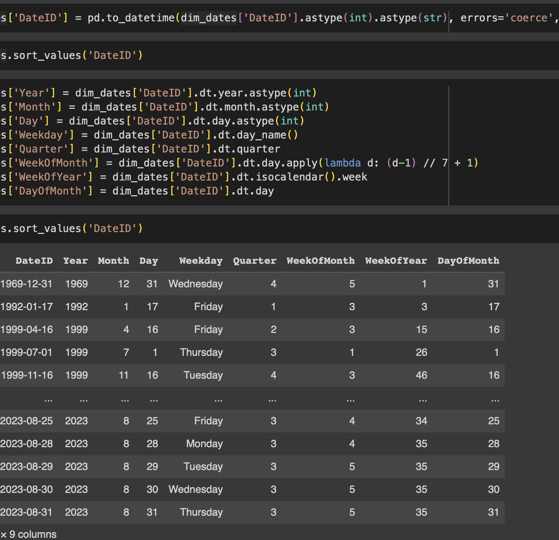
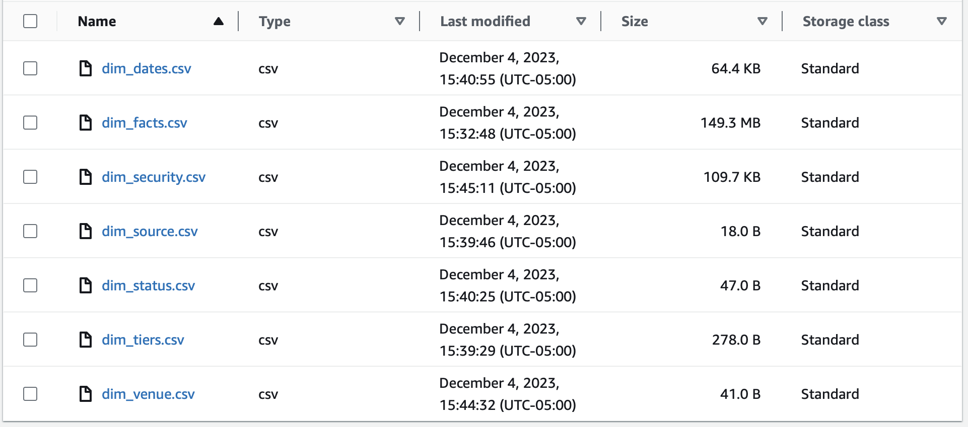
Transform
combined_dates=pd.concat([df['ClosingInsideBidPriceDate'],df['ClosingInsideAskPriceDate'],df['PreviousCloseDate'],df['ClosingBestBidDate'],df['ClosingBestAskDate'],df['ShortInterestDate’]])

Slide 12
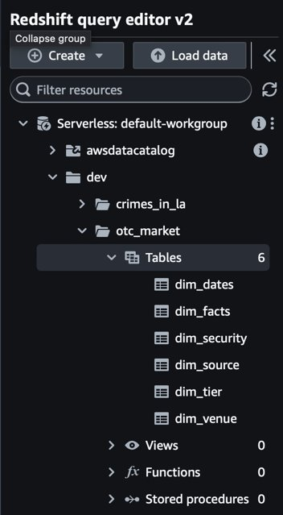
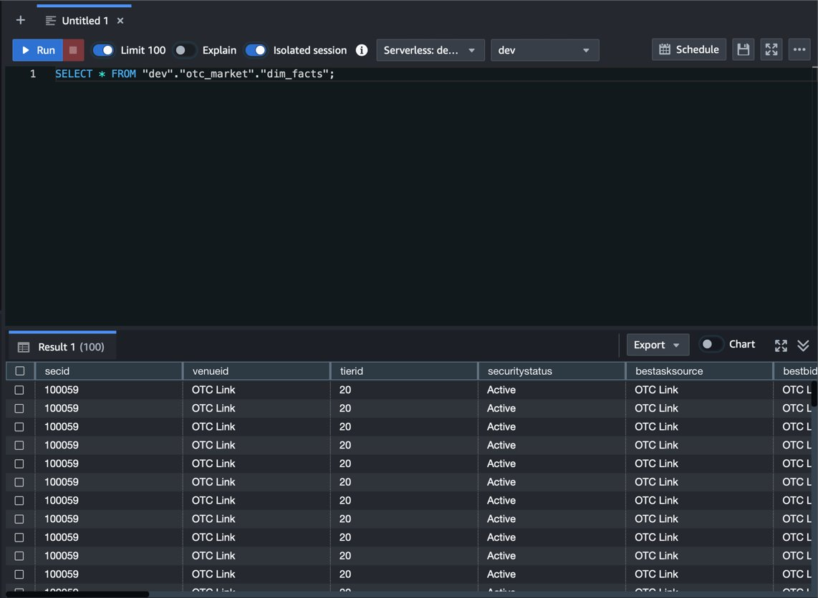
Redshift

Slide 13
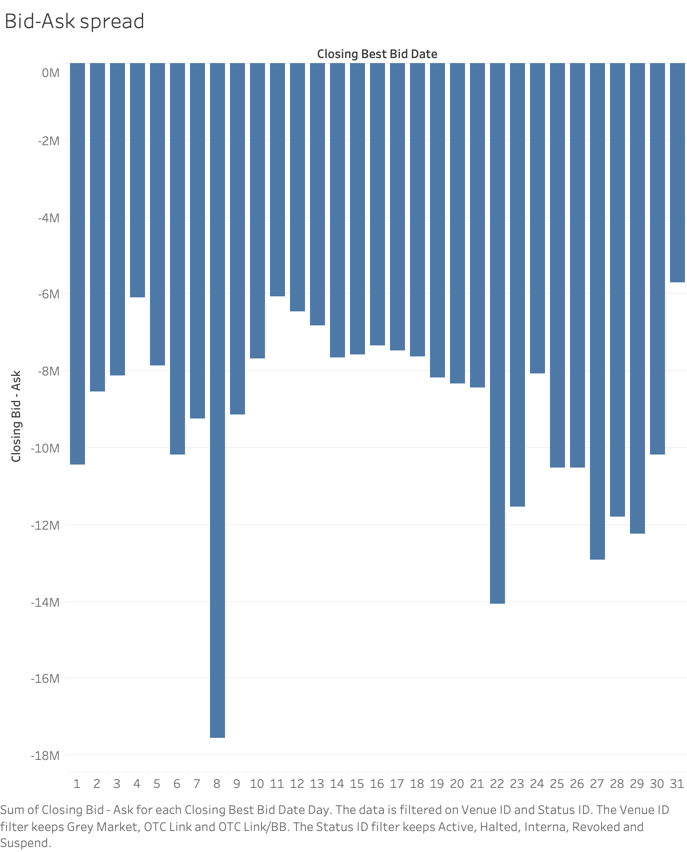

Bid-Ask Spread

Slide 14
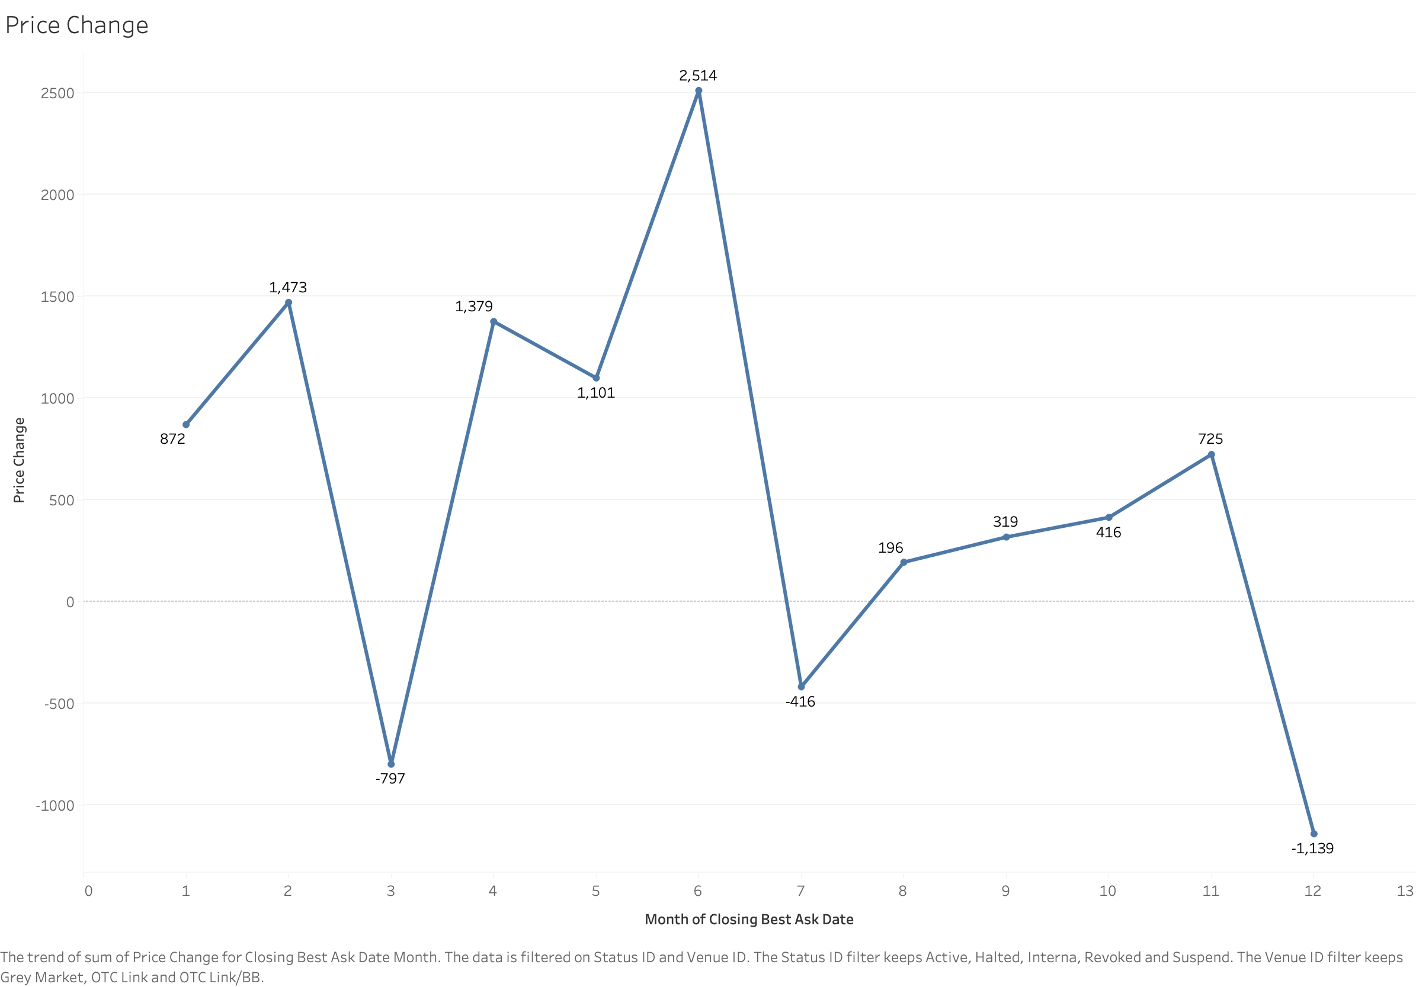
Price Change Over Time

Slide 15
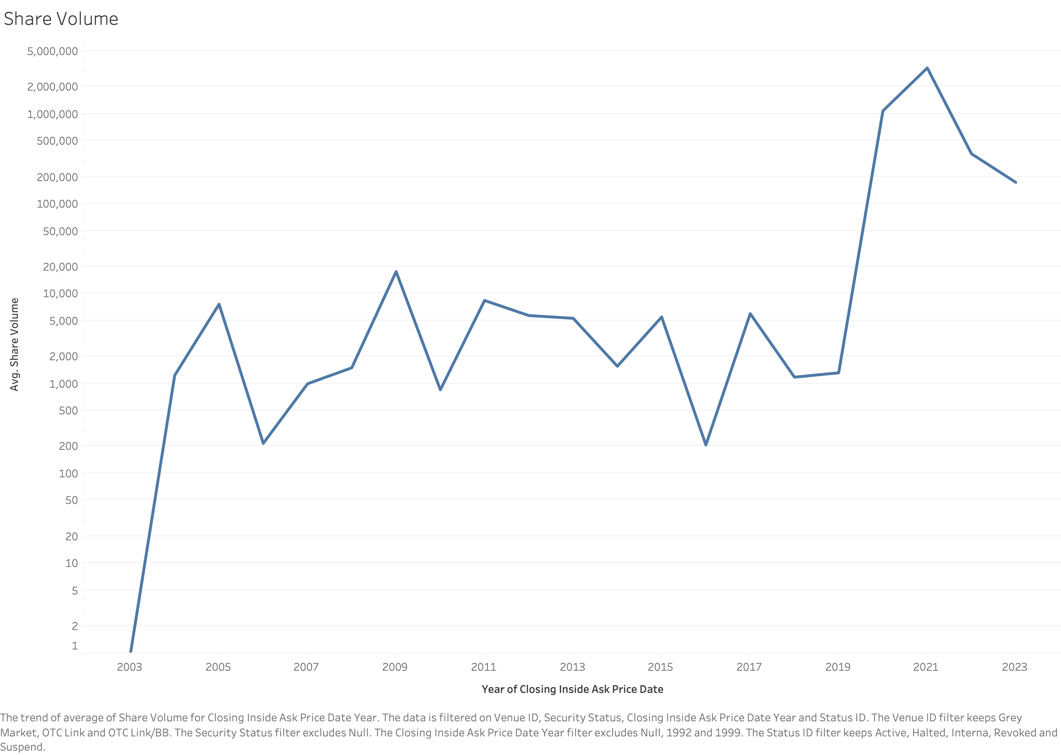
Avg. Share Volume over Time

Slide 16
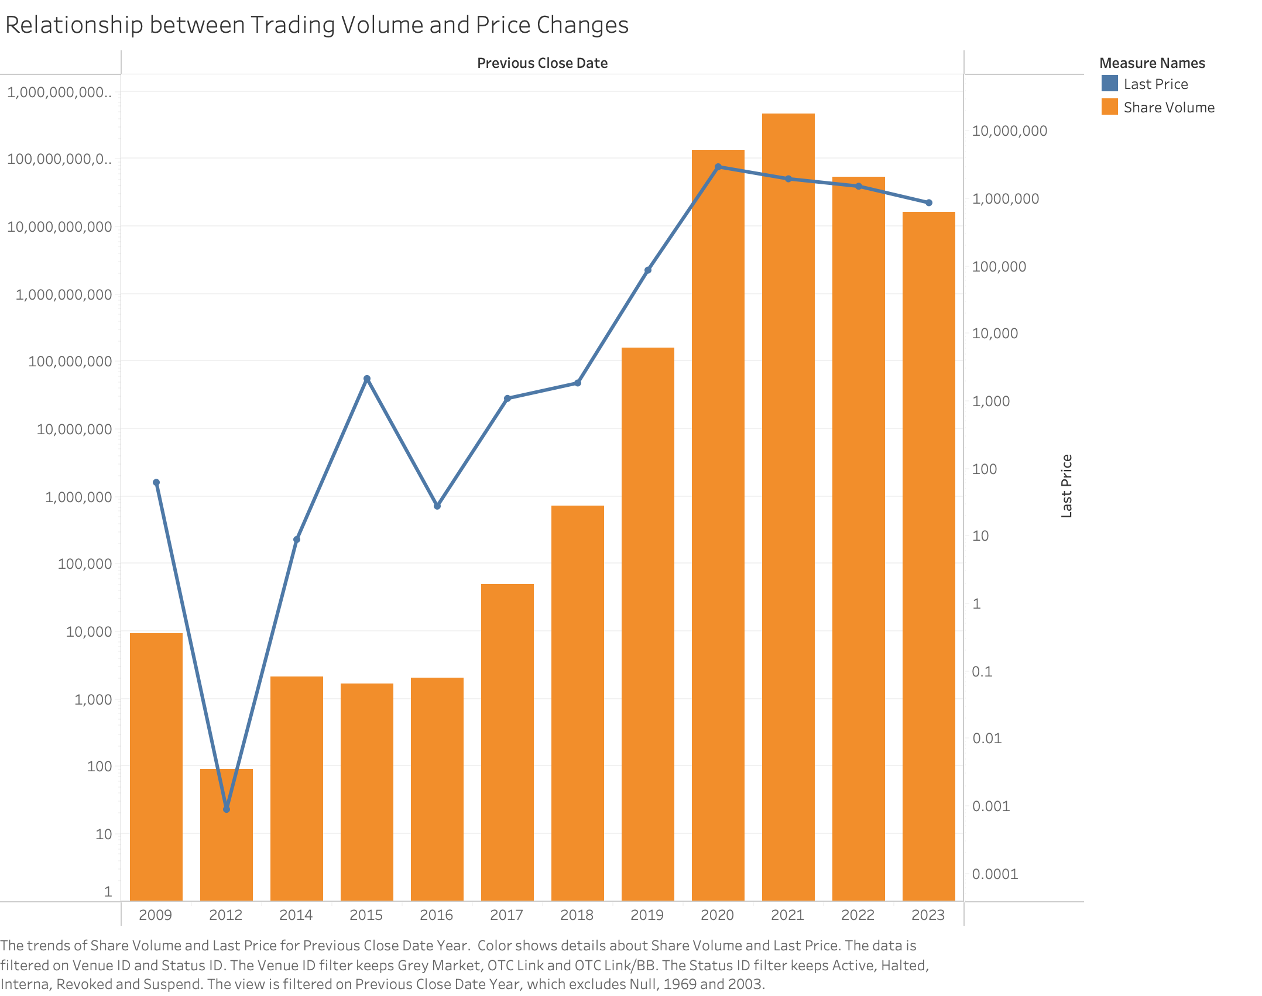
Trading Volume vs Price Change

Slide 17
Thank You
Any Questions?

